Slide 1




Implementation and Doddington Zoo Analysis of a Face Recognition System
ENEL 610 Project
University of Calgary
Venkatesh Amararajan (10012112)
Cheng Li (30100904)

Slide 2
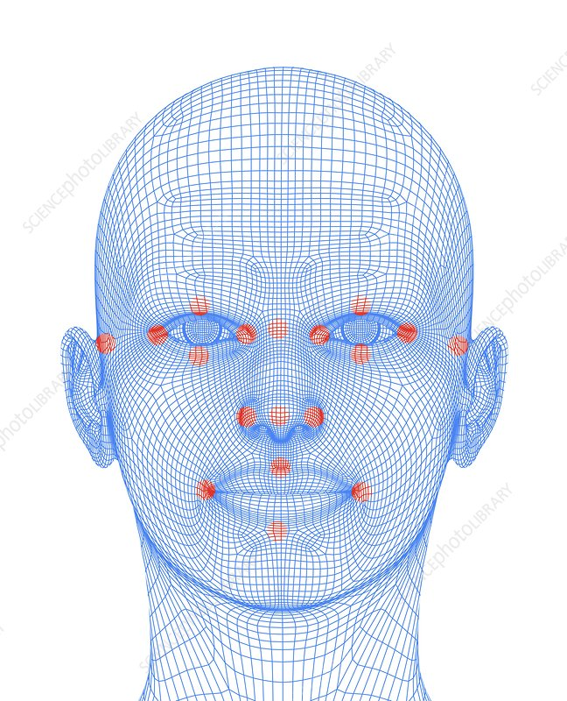
Background and Objective
Facial recognition is one of the important biometrics along with fingerprint and iris recognition
Advancement in the area of deep learning has greatly complimented Facial recognition technology
Wide range of applications: Law enforcement, Job applications, International travel and Banking/financial formalities
Main Goal
Study and Implement a Facial Recognition Model
Apply Doddington Zoo Analysis on the model to test its effectiveness
Credit: ALFRED PASIEKA / SCIENCE PHOTO LIBRARY

Slide 3
Overview of the Face Recognition model
Implementation:
Python Programming language (PyCharm IDE)
Face recognition library (Dlib)
Steps for implementation and analysis of Face Recognition Model
Face Detection
Landmark detection on Faces
Face Encodings
Application of Doddington Zoo Analysis

Slide 4
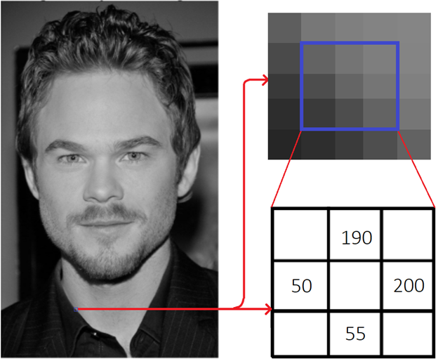
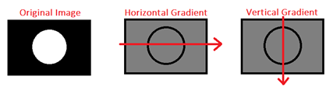
Face Detection: Implementation of Histogram of Oriented Gradients (HOG)
Convert input image to grayscale
Estimating Pixel Gradient Magnitude and Angle
∆f_{x} = 200 - 50 = 150
∆f_{y} = 190 - 55 = 135
Gradient Magnitude = 201.804
Gradient Angle = 41.987 degree
Divide the entire image into smaller squares(16x16)
Count of orientation of each gradient point (up, down, left, right, and all direction in between)
The orientation(represented as an arrow direction) that yielded the majority count within these boxes is assigned
The resulting image will be a HOG image that detects faces in an image
Figure 2 Demonstration of HOG process [7][8][9][10]
Figure 1 HOG Mechanism [9]

Slide 5
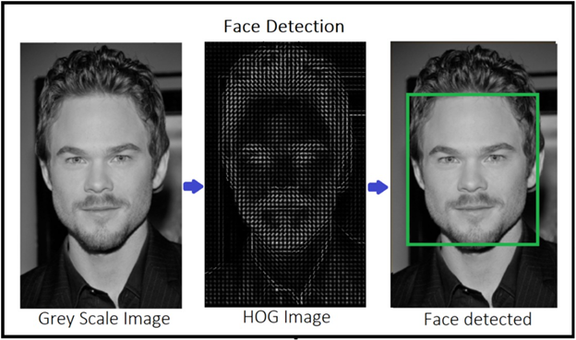
Face Detection: Implementation of Histogram of Oriented Gradients (HOG)
Figure 3 Generation of HOG Image resulting in Face detection

Slide 6
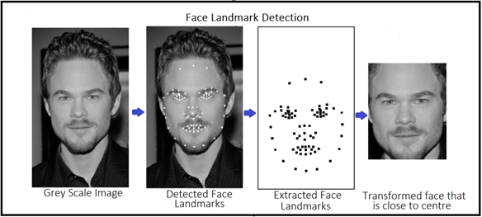
Landmark detection on faces
Figure 4: Face Landmark Detection Process

Slide 7
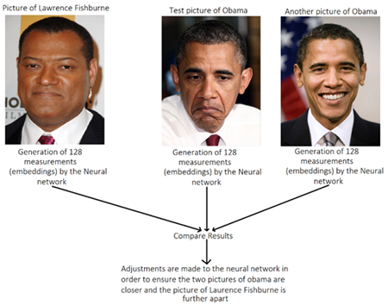
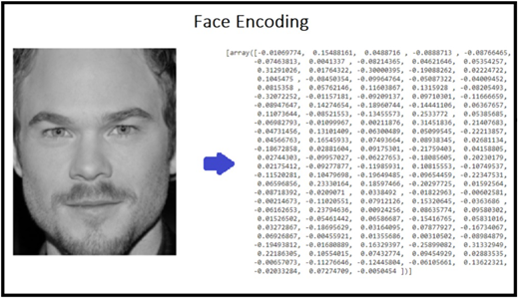
Generation of Face Encoding
Generation of 128 measurements(encodings/embeddings) for each face
Single triplet training
Encodings are unique to each and every individual
Figure 6 “Single Triplet” Training Model
Figure 5 Generation of 128 encodings/embeddings

Slide 8
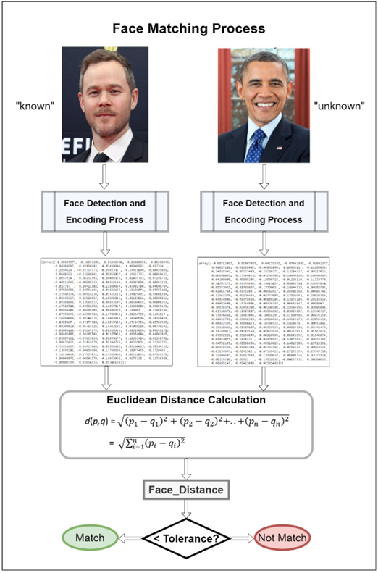
Figure 7: Face Matching Process

Slide 9
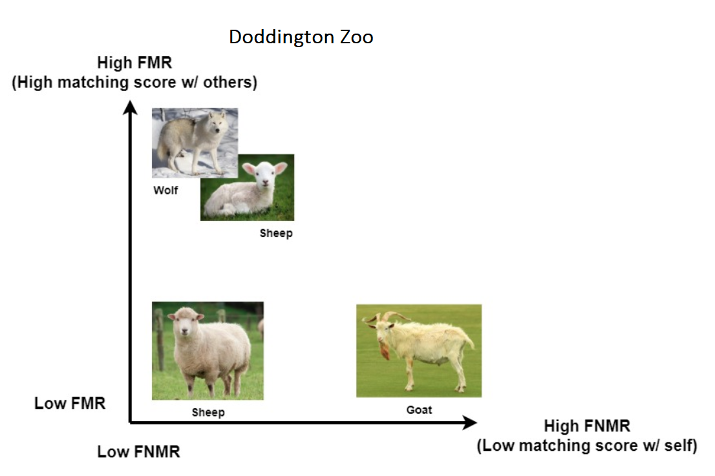
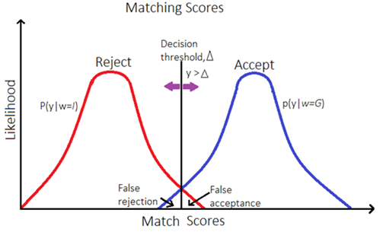
Implementation of Doddington Zoo Analysis
Implementation of Doddington Zoo Analysis
Test the effectiveness of face recognition algorithm
Users are ranked based on their hardness to match
Each user is assigned a Doddington Zoo category: Sheep, Lamb, Goat, Wolf
A predefined threshold value was assigned after numerous tests
Evaluate threshold distance comparing a probe image with test images
Generate curves and histograms for matching scores
FMR/FNMR Analysis
Figure 8: Doddington Zoo [2]
Figure 9: Matching Score and FMR/FNMR Analysis [2]

Slide 10

Program Introduction
Access control system based on face recognition (Simulation)

Slide 11
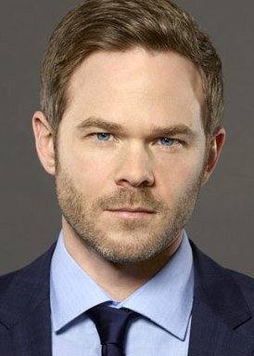
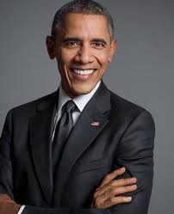
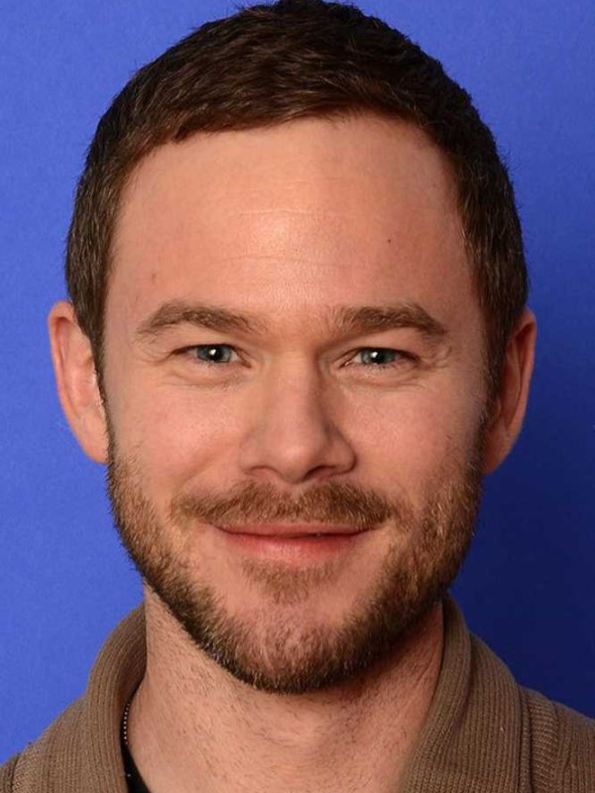
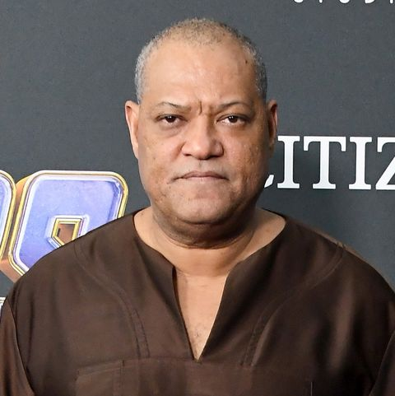
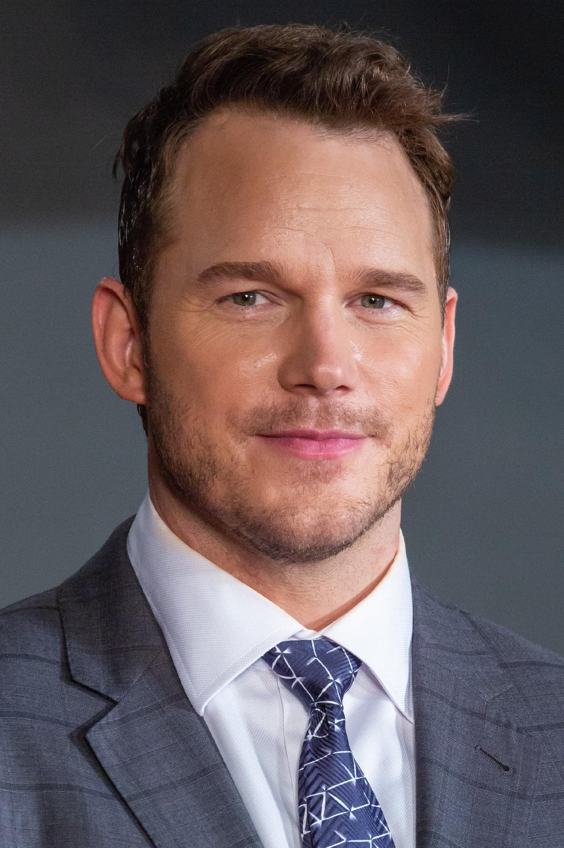
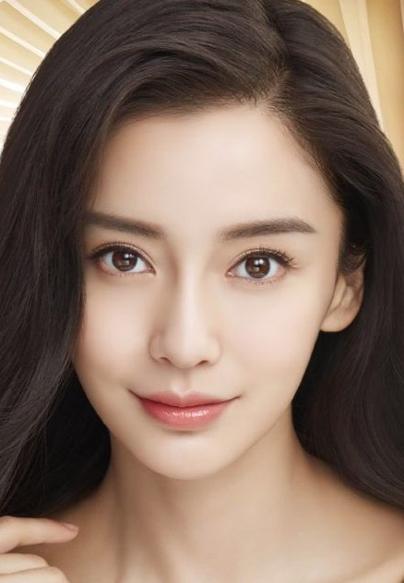
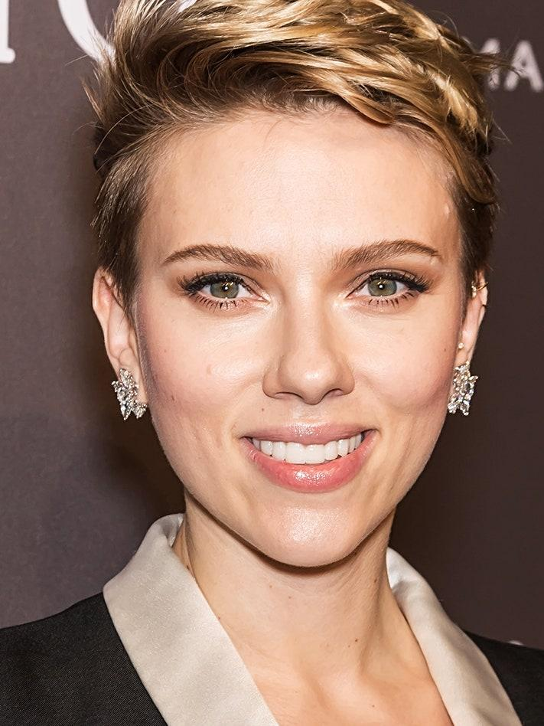

Data Set and Assumption
No. | Name | Category | No. | Name | Category
1 | Shawn Ashmore | Wolf/Lamb | 5 | Barack Obama | Sheep
2 | Aaron Ashmore | Wolf/Lamb | 6 | Laurence Fishburne | Sheep
3 | Chris Pratt | Wolf/Lamb or Sheep | 7 | Angela Yang | Goat
4 | Scarlett Johansson | Sheep | 8 | Eddie Peng | Sheep

Slide 12
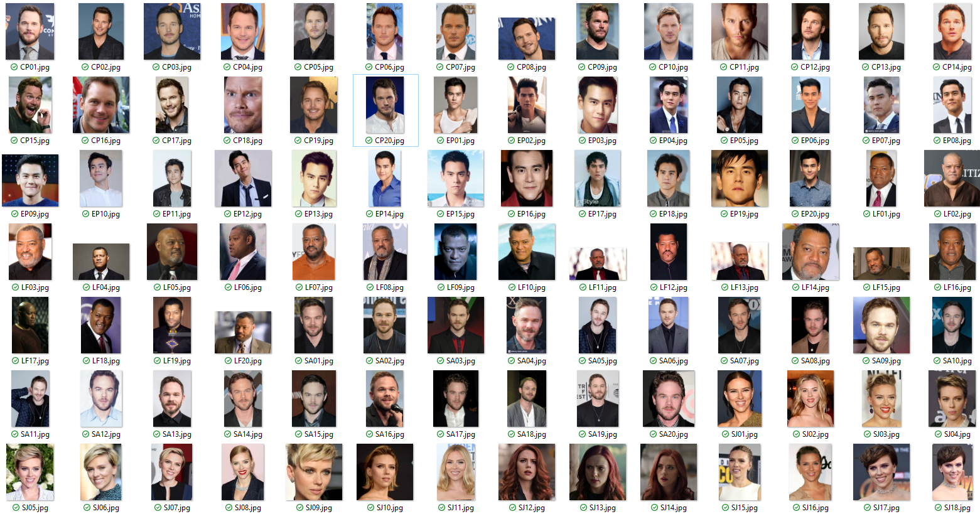



Data Set Preparation
x1
x20
Match
“known” picture(s)
Face(s) registered in the system
“Origins” or “Genuine set”
“unknown” picture(s)
Face(s) to be recognized
“Trails” or “Test set”

Slide 13
Face Recognition (Matching) Mechanism
Match
“known” picture(s)
Face(s) registered in the system
“Origins” or “Genuine set”
“unknown” picture(s)
Face(s) to be recognized
“Trails” or “Test set”

Slide 14



Face Recognition (Matching) Mechanism
Match
M person
M*N attempts
“known” picture(s)
Face(s) registered in the system
“Origins” or “Genuine set”
“unknown” picture(s)
Face(s) to be recognized
“Trails” or “Test set”

Slide 15


Face Recognition (Matching) Mechanism
Match RESPECTIVELY
K persons
K*1 original
M persons
M*N attempts
M*N*K matches
“known” picture(s)
Face(s) registered in the system
“Origins” or “Genuine set”
“unknown” picture(s)
Face(s) to be recognized
“Trails” or “Test set”

Slide 16



Face Recognition (Matching) Mechanism
Match RESPECTIVELY
K persons
K*L original
M persons
M*N attempts
M*N*K*L matches
“known” picture(s)
Face(s) registered in the system
“Origins” or “Genuine set”
No training process
“unknown” picture(s)
Face(s) to be recognized
“Trails” or “Test set”

Slide 17
Matching Criteria
Face feature detection
Euclidean distance
“Tolerance”
Threshold

Slide 18
Matching Criteria
Face feature detection
Euclidean distance
“Tolerance”
Threshold
Match = True
Access accepted
Match = False
Access denied

Slide 19
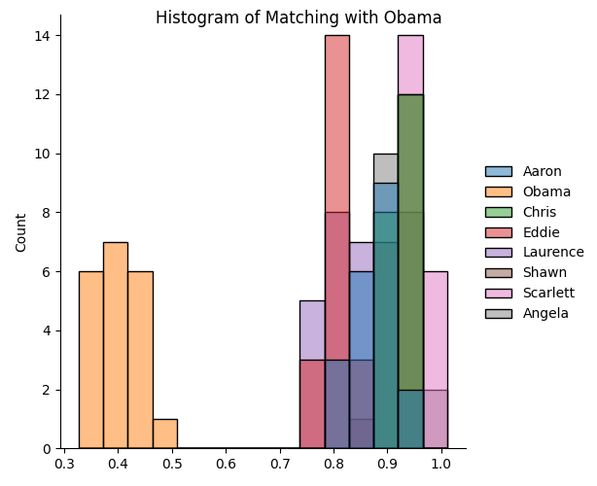
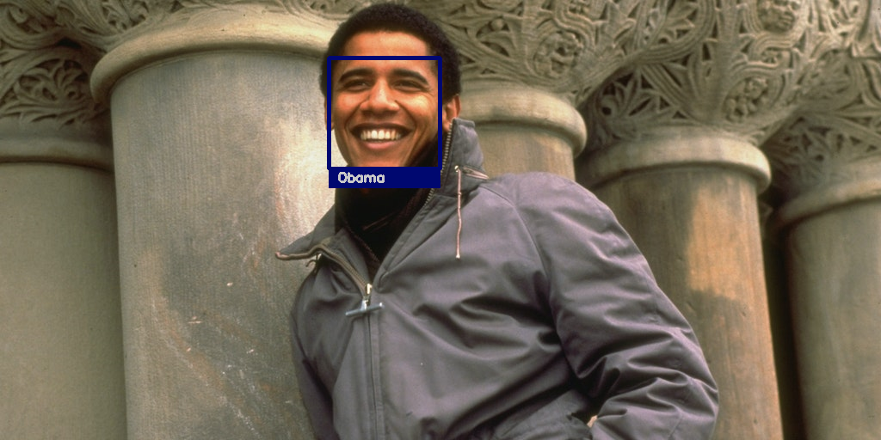
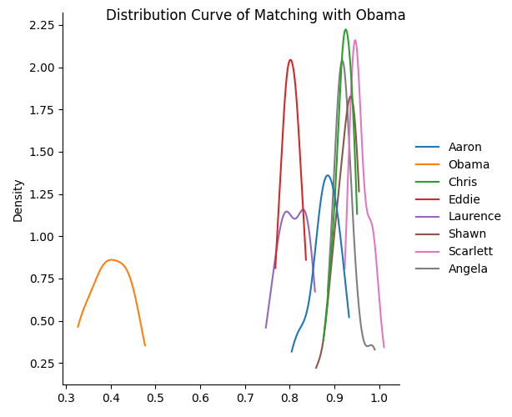
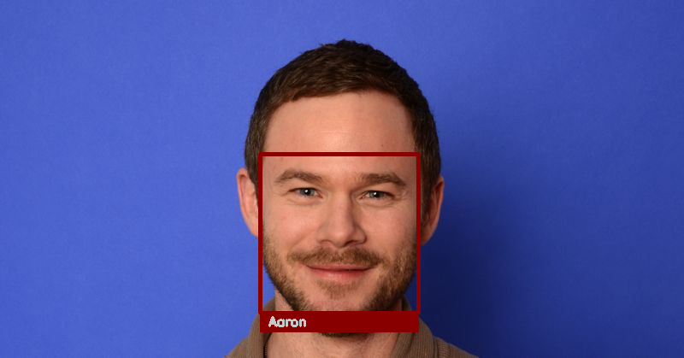
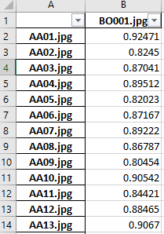
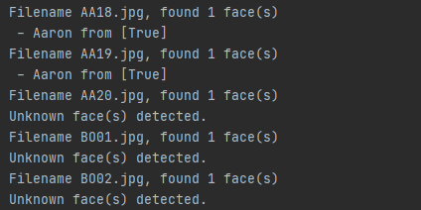
Program Demonstration
For data analysis
For foreground output (labelling)

Slide 20
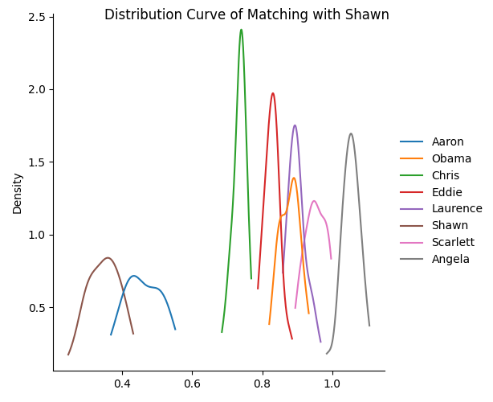
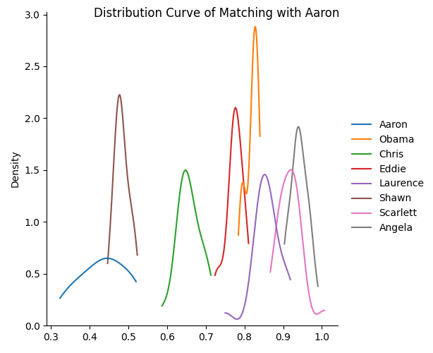
Result Analysis
“Lamb/Wolf” Category

Slide 21
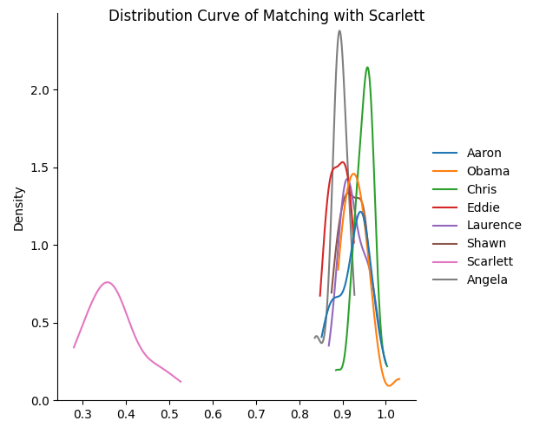

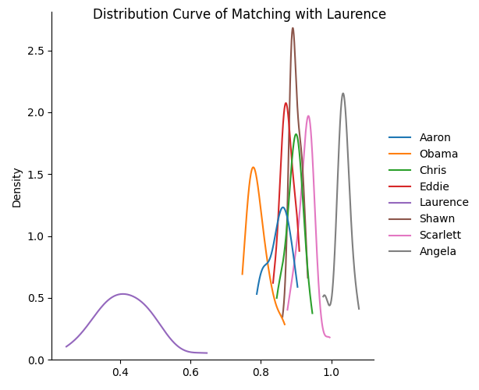
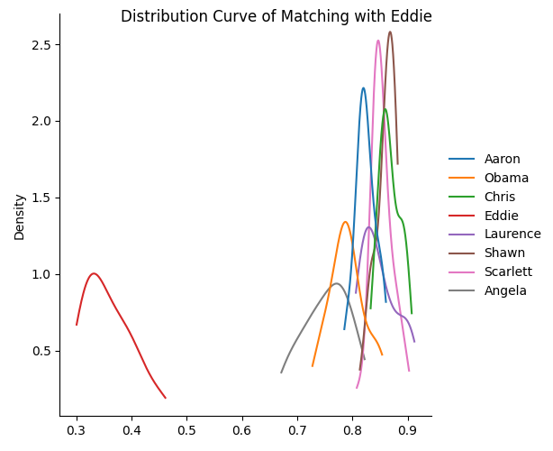
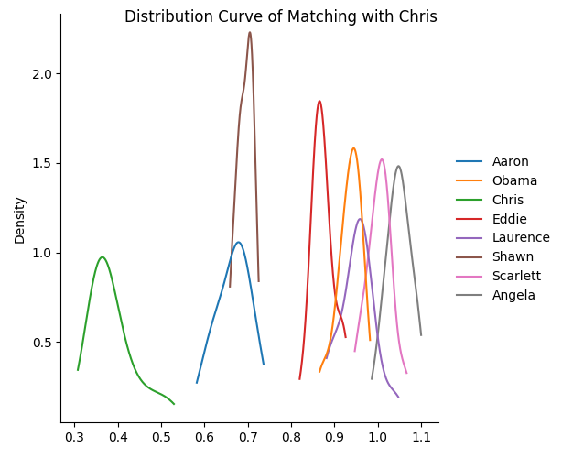
Result Analysis
“Sheep” Category

Slide 22
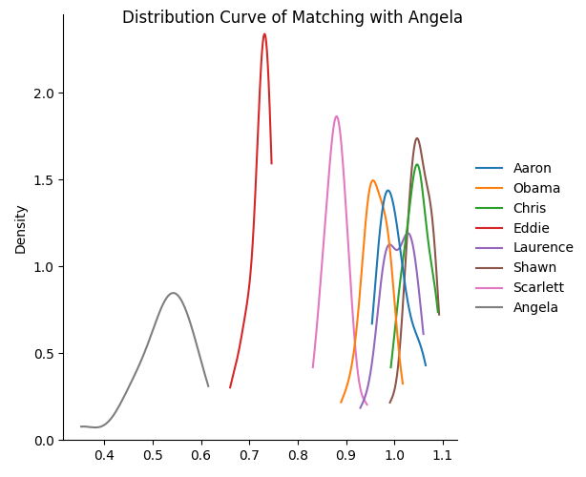
Result Analysis
“Goat” Category
“Sheep” Category

Slide 23
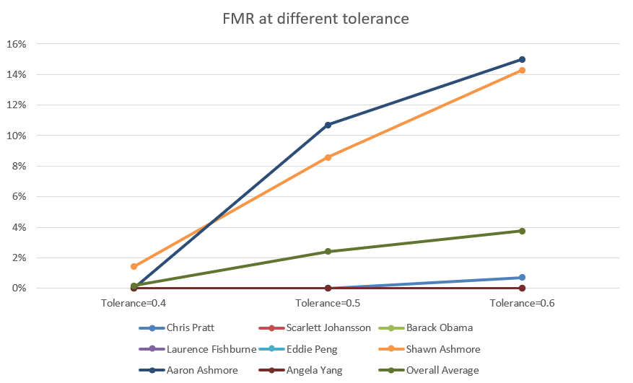
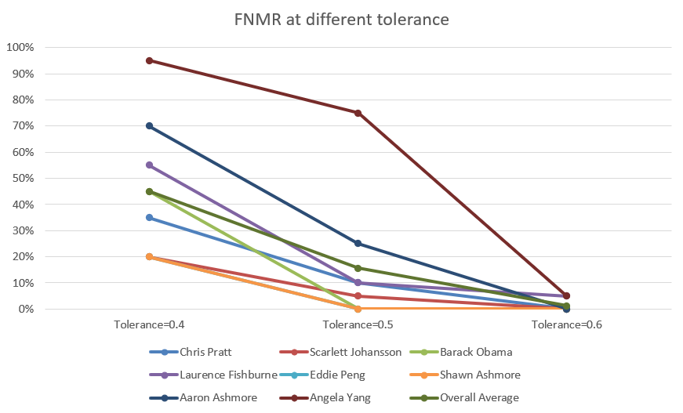
Result Analysis
Tolerance and FMR/FNMR

Slide 24
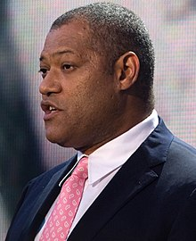
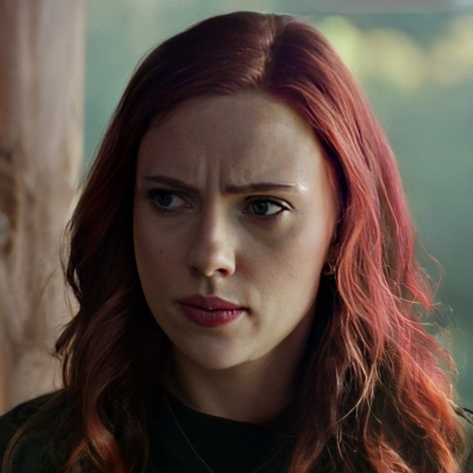
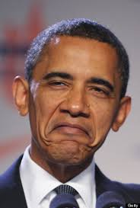
Result Analysis
Side Face: High
Shadow on Face: Mid
Facial Expression: Low
Impact to Recognition

Slide 25
Thank you!
Implementation and Doddington Zoo Analysis
of a Face Recognition System
Repository: https://github.com/vamar123/ENEL-610-Project

